Slide 1
TASK 3: FINDING VULNERABILITY OF A GIVEN WEBSITE USING BURPSUIT
STEPS:
STEP 1: OPEN KALI LINUX FORM VMWARE
STEP 2: OPEN BURPSUIT AND CHECK WHETHER THE INTERCEPT IS ON

Slide 2
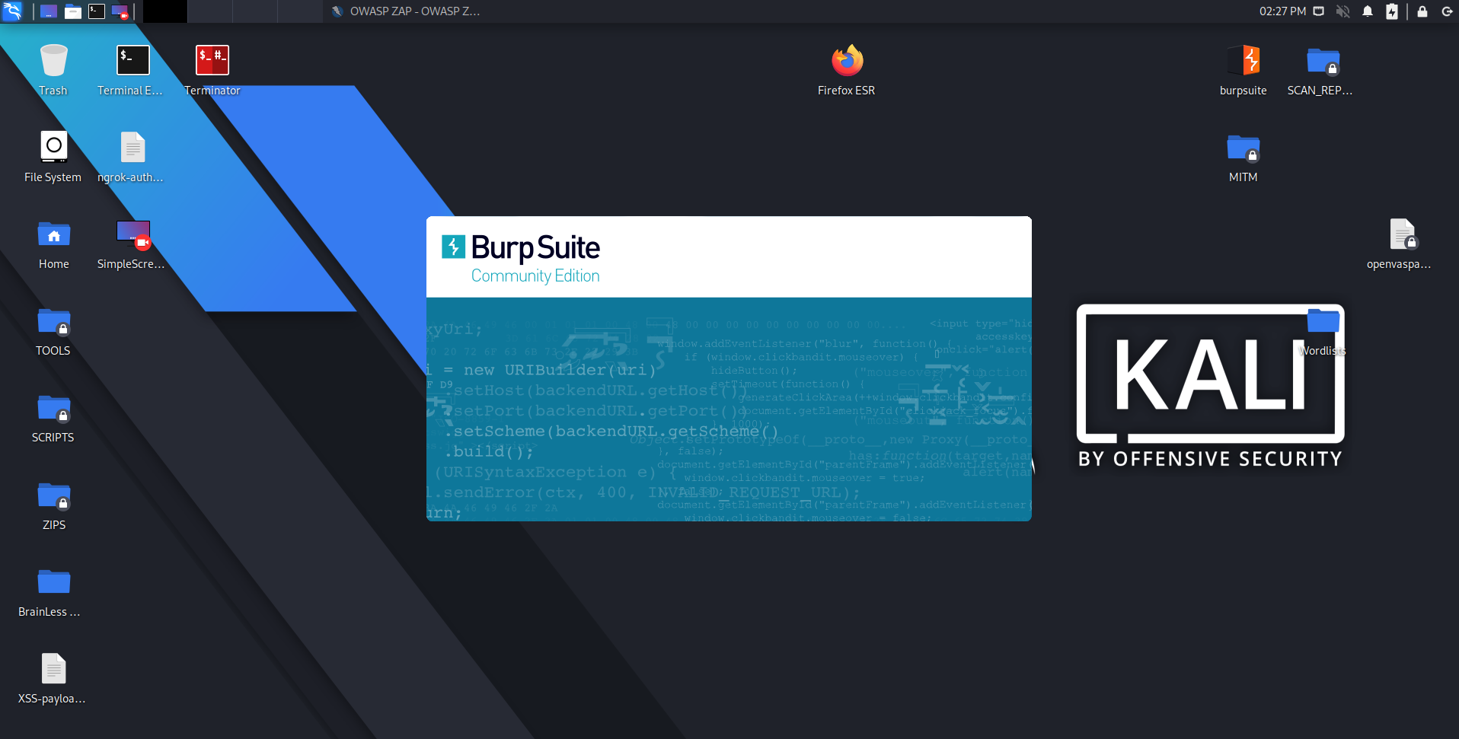

Slide 3
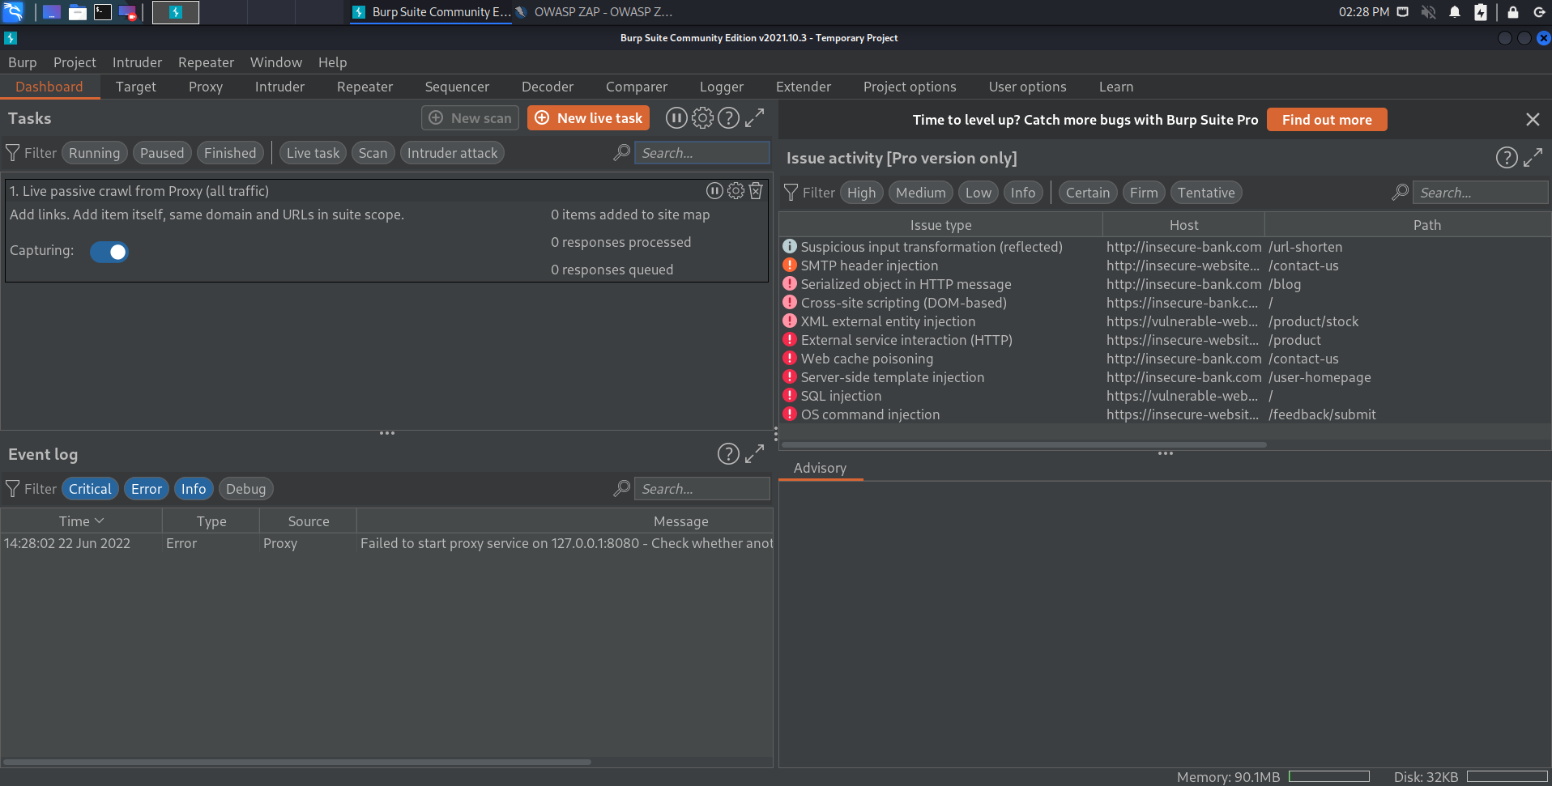

Slide 4
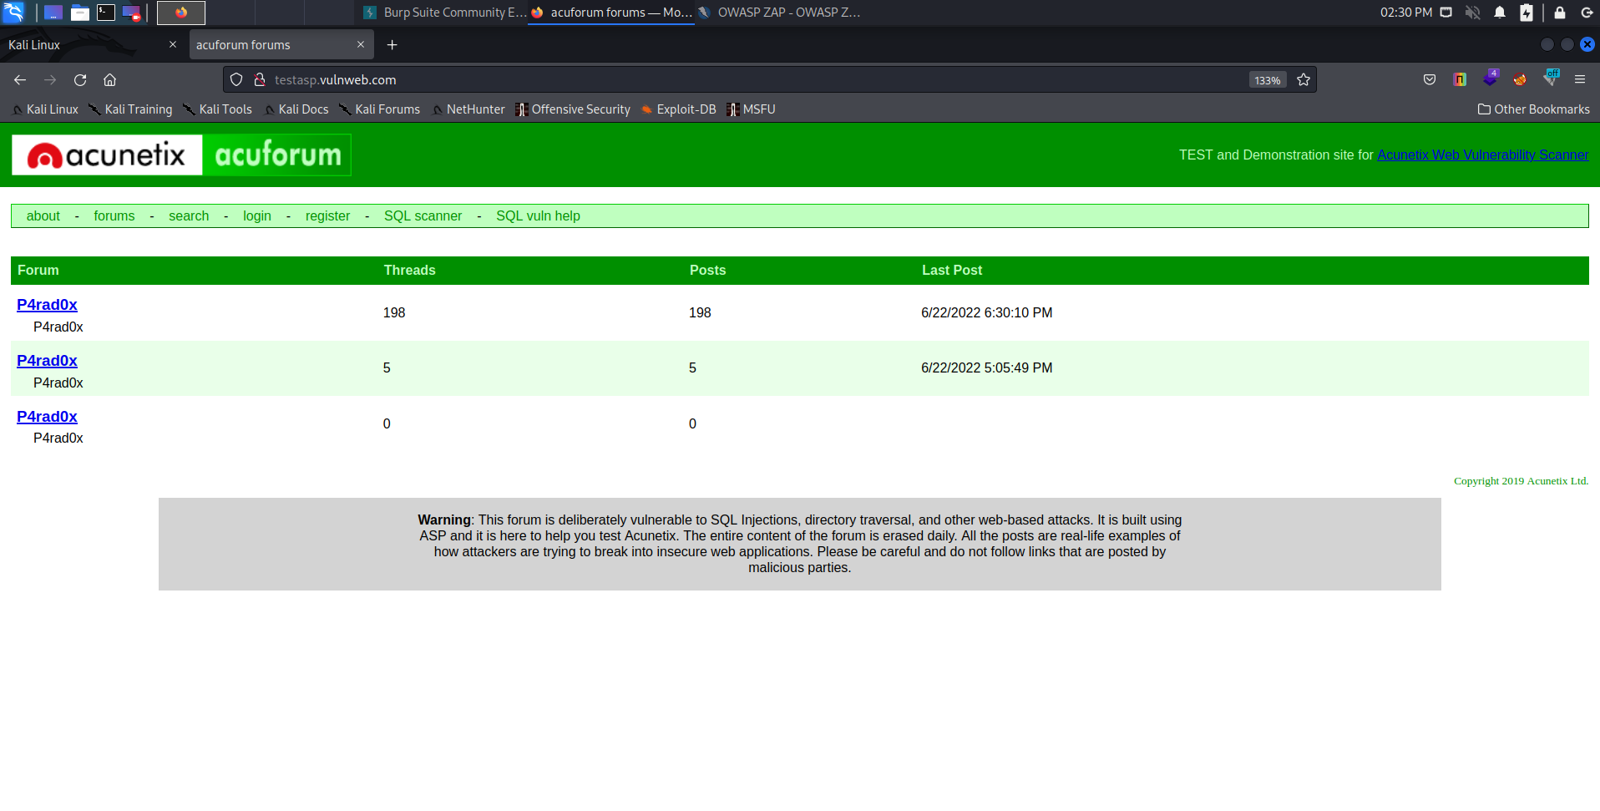
STEP 3: OPEN FIREFOX AND SEARCH FOR VULNWEB THEN GO TO http://testasp.vulnweb.com

Slide 5
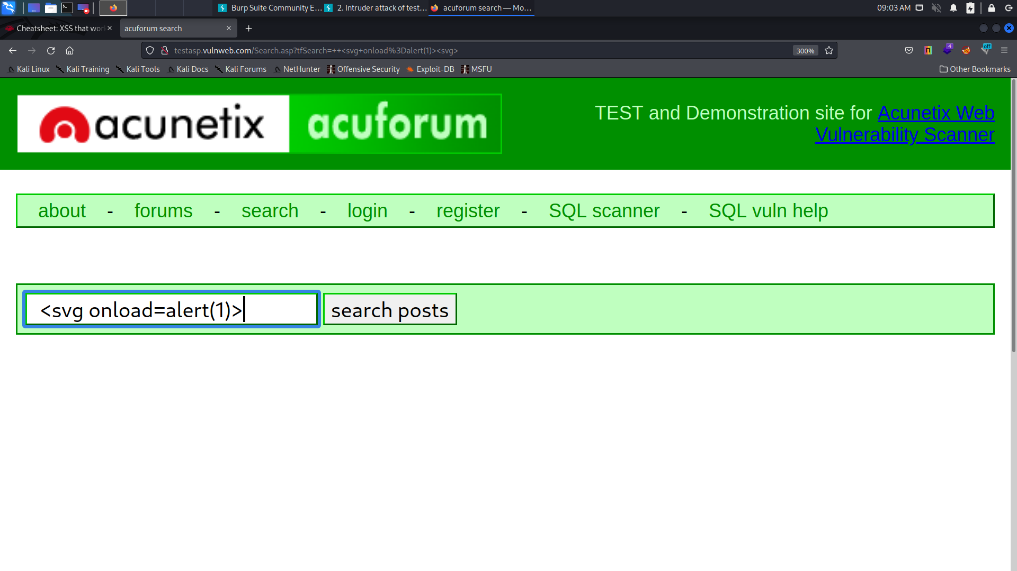
STEP 4: GO TO THE SEARCH OPTION AND TYPE A PROMPT

Slide 6
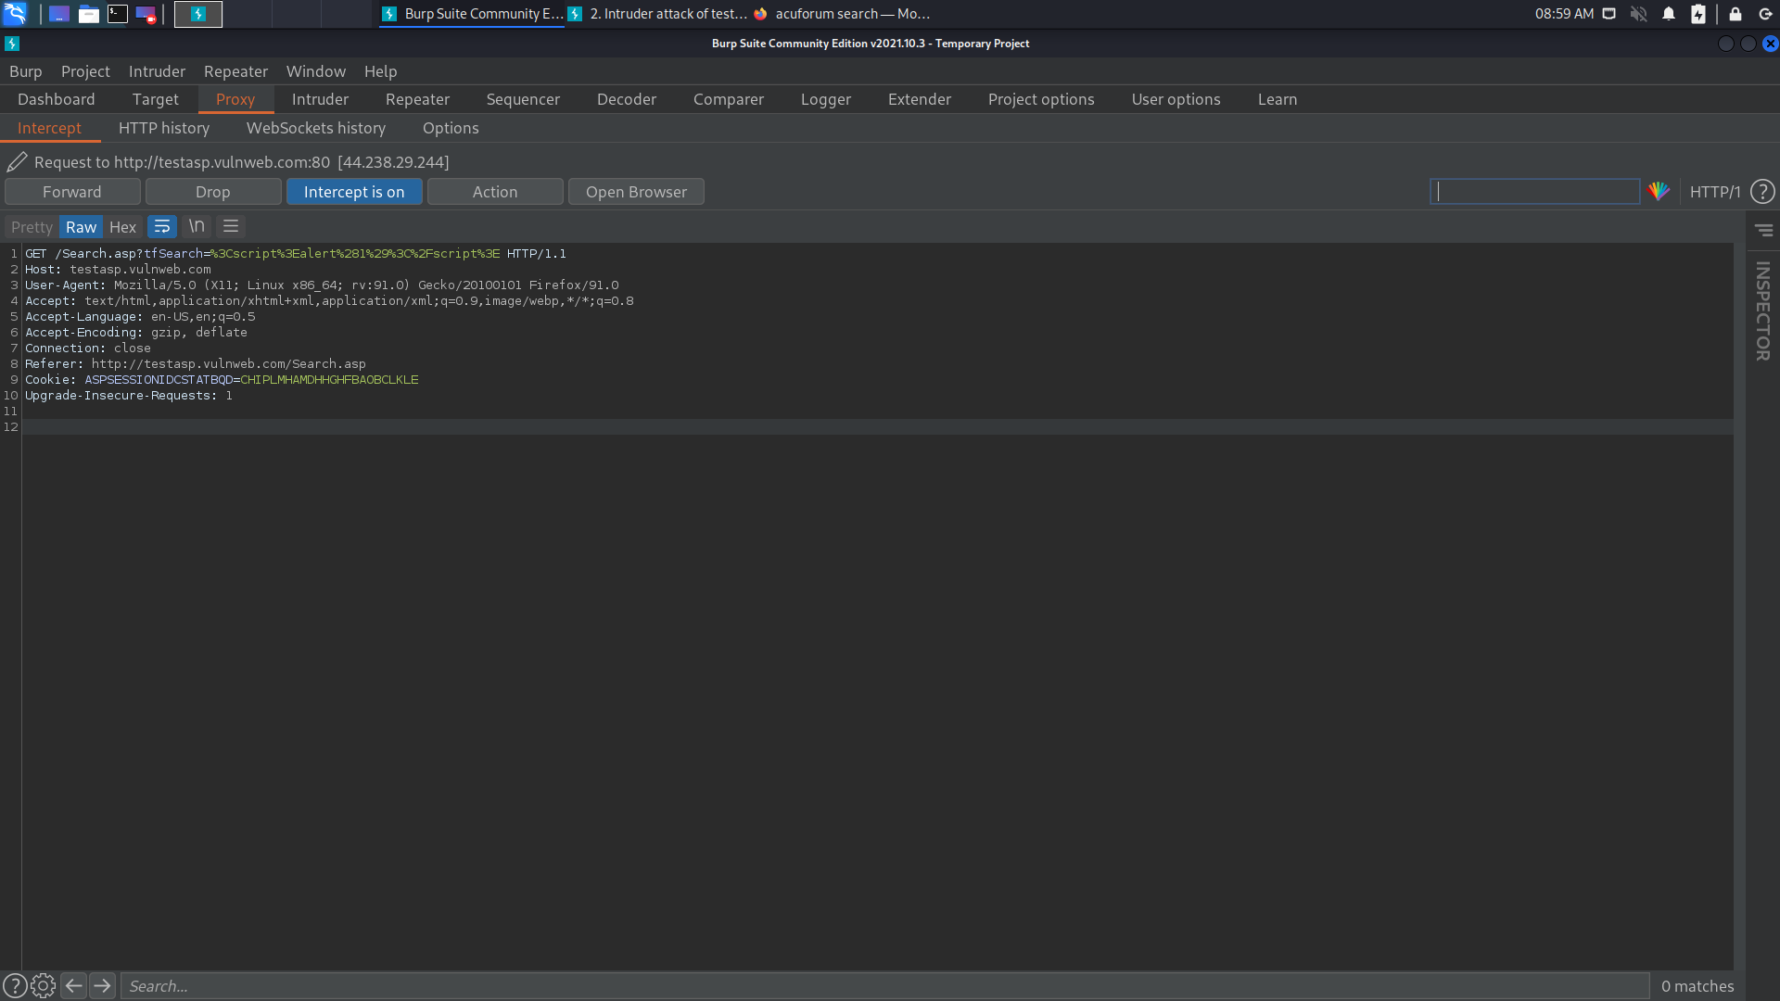
STEP 5: TRUN ON BURP FROM FOXYPROXY AND TRUN INTERCEPT ON IN BURPSUIT AND ENTER THE PEOMPT

Slide 7
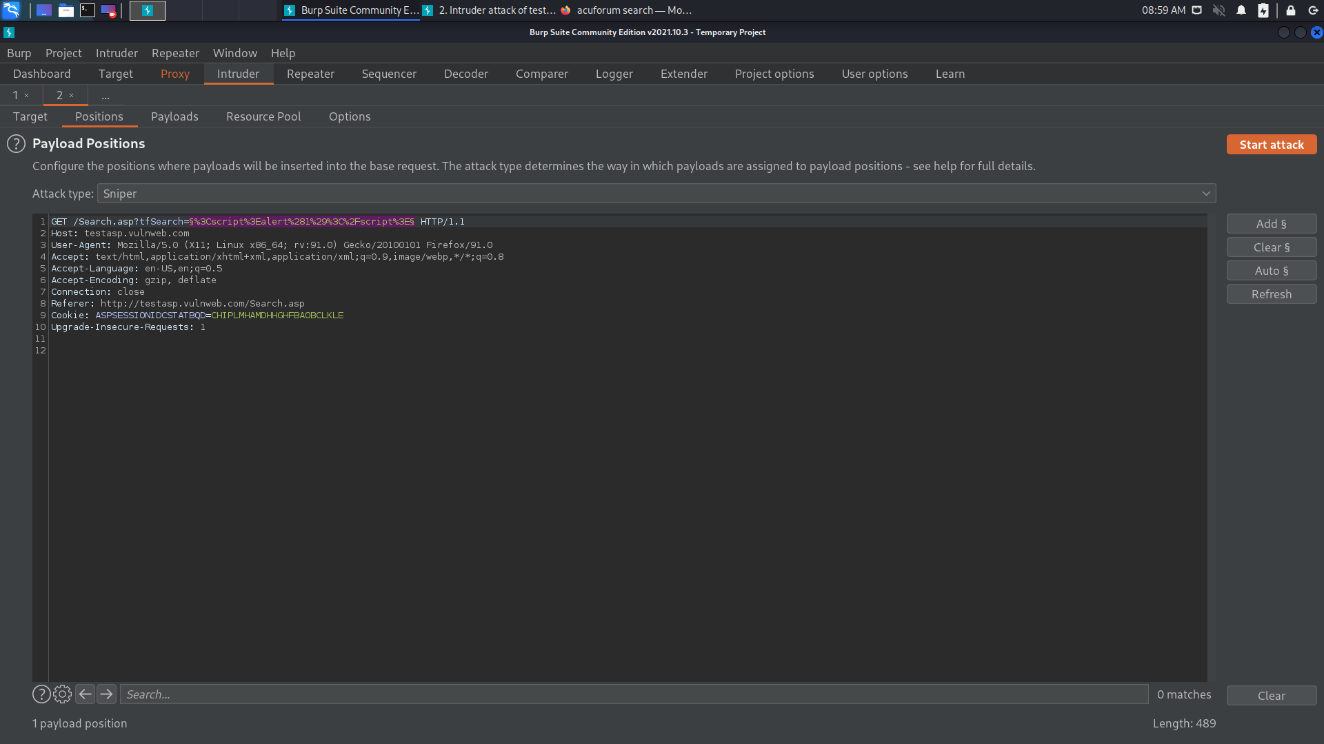
STEP 6: AFTER THE SEND THE REQUEST TO INTRUDER , CLICK CLEAR AND SELECT THE PLACE FOR PAYLOAD. THEN CLICK ADD

Slide 8
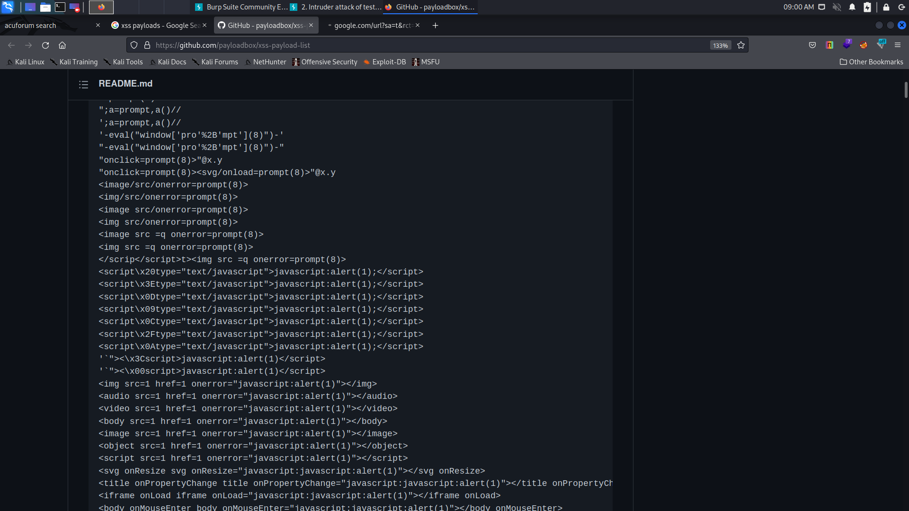
STEP 7: GO TO GITHUB AND SELECT THE PAYLOAD

Slide 9
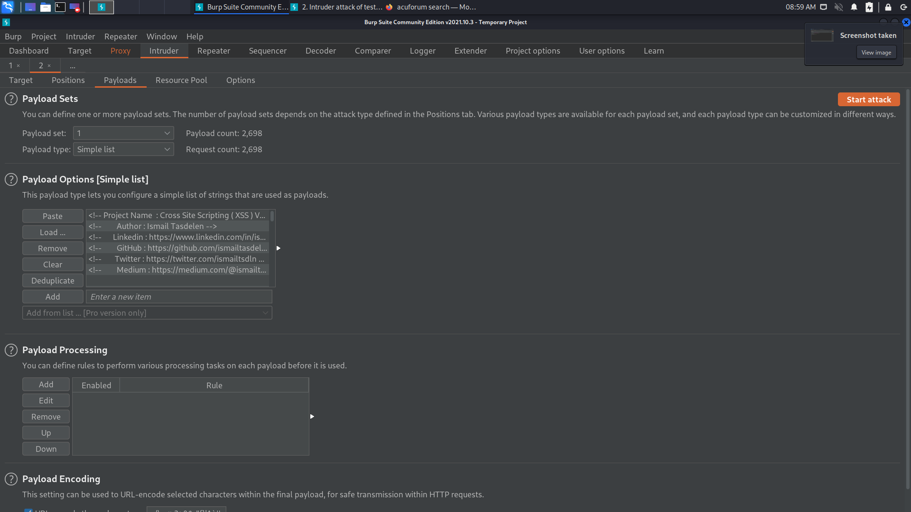
STEP 8: tHEN GO TO PAYLOADS SECTION OF INTRUDER AND SELECT PASTE

Slide 10
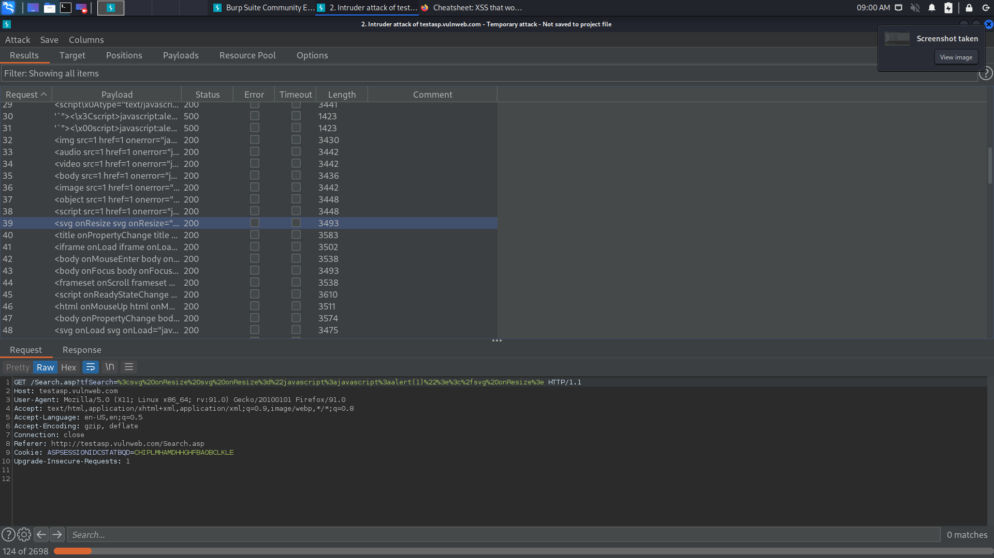
STEP 9: THEN START ATTACK

Slide 11
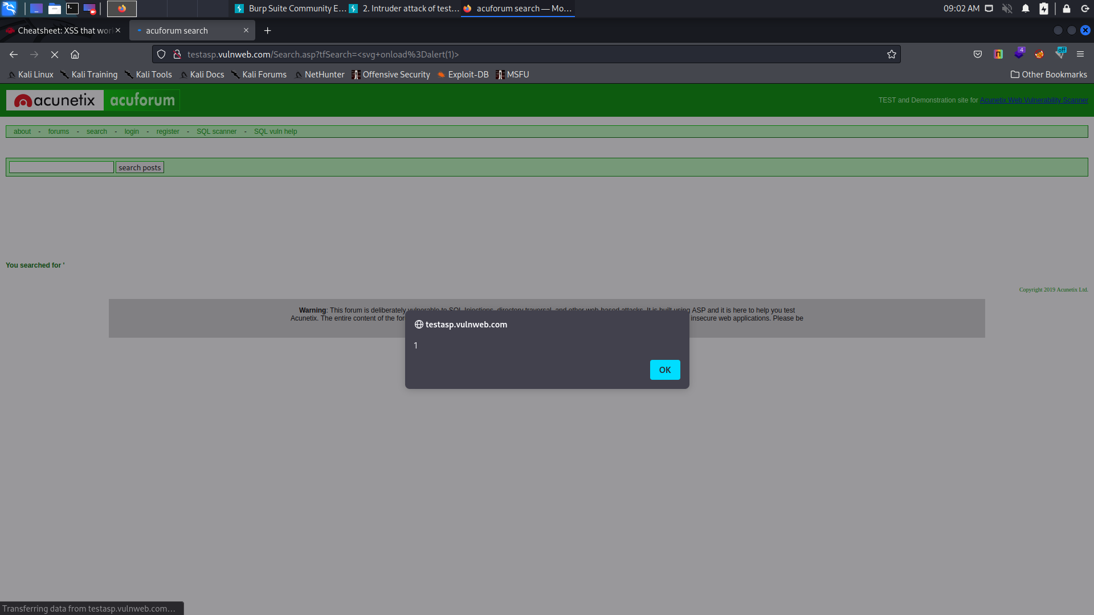
STEP 10: GO TO SEE RESPONSE IN BROWSER AND COPY THE URL AND PASTE IN BROWSER AND HIT ENTER. THEN YOU WILL BE PROMPTED AND THE REQUIRED INTERFACE WILL BE IN THIS FORM

Slide 12
HENCE WE CAN SAY THAT THE WEBSITE IF VULNERABLE TO XSS ATTACK

